Slide 1
COLLEGE PROJECT DEFENSE • DATA ANALYSIS & ML
Decoding Airfoil Self-Noise
Investigating aerodynamic & operating factors influencing acoustic sound pressure levels
BY:
JASVINGURU S.(lead) KARTHICK S.
JANAK S .V.
KIRITHIC M.

Slide 2
RESEARCH CORE OBJECTIVE
The Problem Statement
To figure out which factors—like speed, wing size, angle of attack, and air boundary thickness—have the biggest impact on the noise an airfoil creates.
Primary Aim: Quantify how wing flight conditions dictate noise emission level.
NASA BENCHMARK DATASET
1,503
Key Question: Which parameter exerts strongest dominance over decibel output?
Engineering Goal: Identify optimal parameters for ultra-quiet aerodynamic wings.
Experimental aerodynamic test runs evaluated across anechoic wind tunnel conditions.

Slide 3
EXPERIMENTAL VARIABLES
5 Key Aerodynamic Parameters
INPUT f
INPUT α
INPUT c
INPUT U∞
TARGET SSPL
Frequency
Angle of Attack
Chord Length
Velocity
Sound Level
Sound pitch range (200–20,000 Hz).
Wing tilt angle relative to wind.
Physical length from front to back.
Oncoming air speed (31–71 m/s).
Acoustic output (103–140 dB).

Slide 4


INTUITIVE MENTAL MODEL
Car Window Highway Analogy
Fast Driving(Velocity)
Tilting Hand(Angle of Attack)
Air Swirls(Displacement Thickness)
Whistle Pitch (Frequency )
Higher airspeed creates louder rushing wind noise.
Steeper tilt angle catches air and vibrates harder.
Thicker turbulent air layer rolling over the hand.
Frequency shift from deep rumbles to high shrieks.

Slide 5

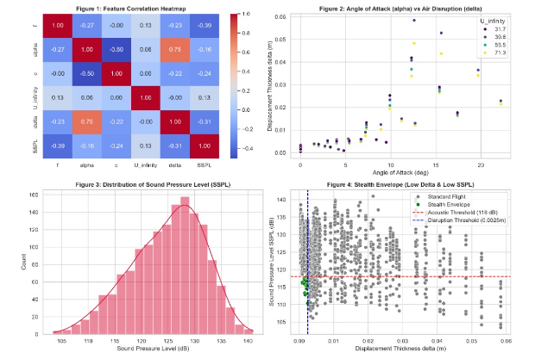
DATA ANALYSIS INSIGHTS
Exploratory Visualizations
Inverse Frequency Effect
Sound level drops significantly at higher pitch frequencies.
Angle Disruption Spike
Steeper angle exponentially thickens turbulent air layer.

Slide 6
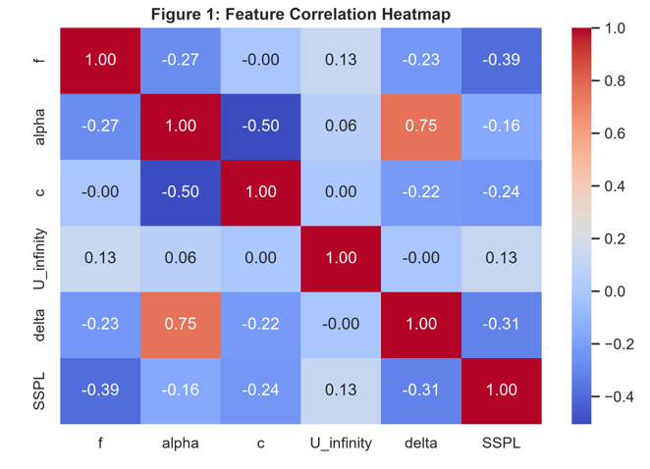
Identifies Key Relationships: Shows how different aerodynamic parameters relate to one another.
Strongest Positive Link (0.75): Angle of attack (alpha) has a high positive correlation with air displacement thickness (delta), meaning higher angles create larger air disruption.
Noise Impact: Frequency (f) and SSPL show negative correlations with several features, helping pinpoint which variables directly drive noise generation.
Key Takeaway: Allows us to focus on critical parameters like alpha and delta rather than redundant data.

Slide 7
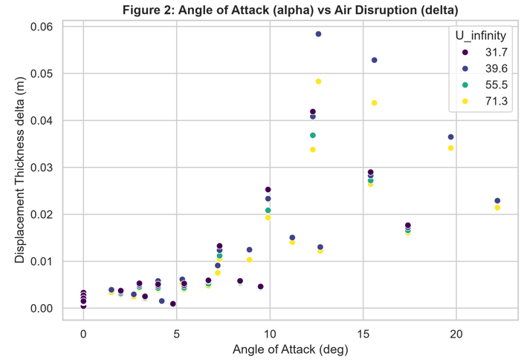
Direct Impact of Pitch: As the angle of attack (alpha) increases, air disruption (delta) increases significantly.
Stable at Low Angles: Below 10 degrees, boundary layer disruption remains very low across all flight speeds (U_infinity).
Turbulence Spike: Beyond 12–15 degrees, air disruption spikes sharply due to flow separation.
Key Takeaway: Keeping the aircraft at lower angles of attack prevents heavy air disruption and maintains smooth airflow

Slide 8
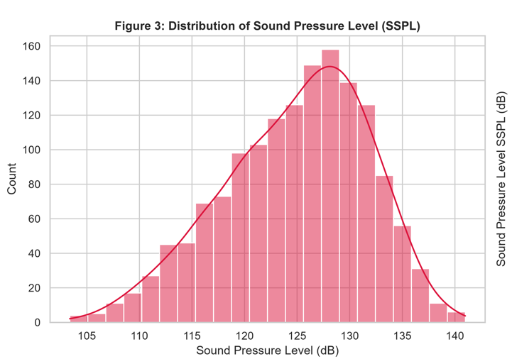
Overall Noise Profile: Illustrates the complete range and frequency of noise levels generated during testing.
Peak Noise Level: Most test conditions produce sound levels concentrated between 125 dB and 130 dB.
Left-Skewed Tail: A smaller portion of flight conditions achieves quieter operation below 115 dB.
Key Takeaway: Proves standard operations are noisy, highlighting the need for targeted noise-reduction strategies

Slide 9
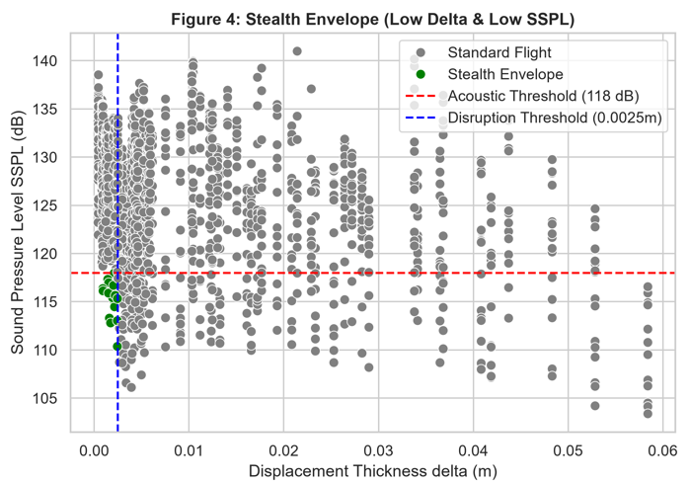
Overall Noise Profile: Illustrates the complete range and frequency of noise levels generated during testing.
Peak Noise Level: Most test conditions produce sound levels concentrated between 125 dB and 130 dB.
Left-Skewed Tail: A smaller portion of flight conditions achieves quieter operation below 115 dB.
Key Takeaway: Proves standard operations are noisy, highlighting the need for targeted noise-reduction strategies

Slide 10

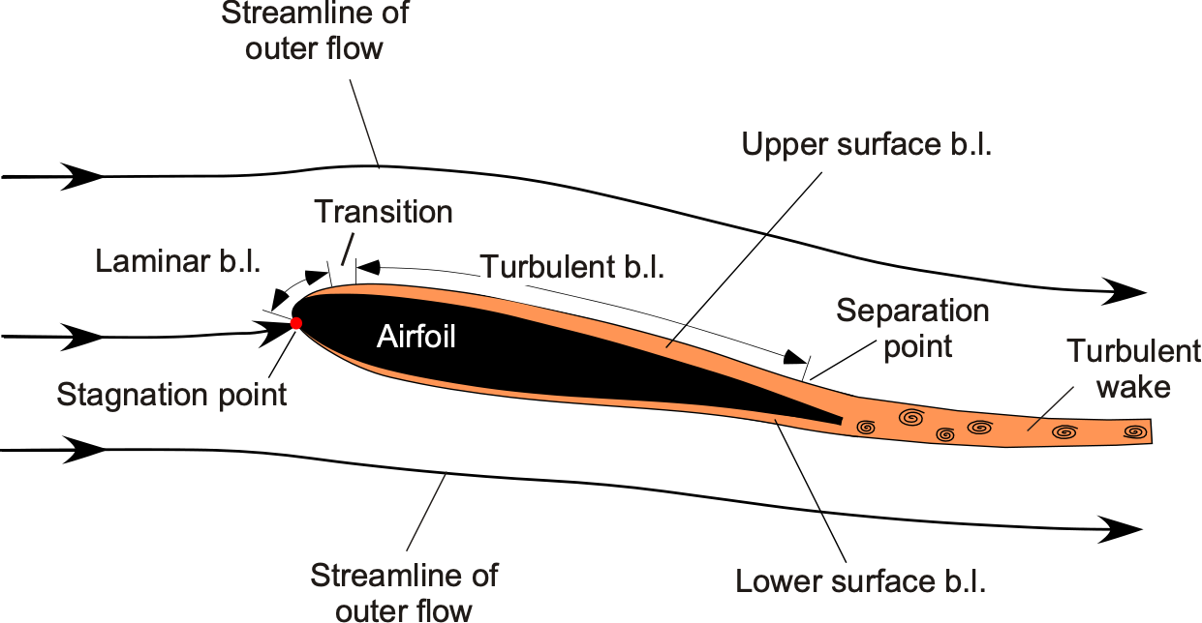
PHYSICS MECHANISM
Boundary Layer & Noise Creation
Surface Friction: Smooth flow turns turbulent along the top suction surface.
Displacement Layer (δ): Boundary thickness creates acoustic pressure waves.
Trailing Edge Scatter: Turbulent vortices leave edge as far-field sound noise.

Slide 11
FEATURE CORRELATION FINDINGS
Strongest Relationships Identified
RANK 1
RANK 2
RANK 3
-0.39
-0.31
+0.75
Frequency (f)
Disruption (δ)
Angle (α vs δ)
Dominant inverse driver of sound level.
Direct physical acoustic turbulence marker.
Primary cause of boundary layer growth.

Slide 12
MACHINE LEARNING VALIDATION
Random Forest Predictor Performance
TARGET 1
TARGET 2
98.27%
90.41%
Air Disruption R² Score
Sound Level SSPL R² Score
Near-perfect prediction of boundary thickness delta.
Highly accurate acoustic decibel output modeling.

Slide 13


PRACTICAL APPLICATIONS
Quieter Airfoil Design Guidelines
Stealth Envelope
Low Angle Operation
Smooth Air Control
Keep boundary thickness below 0.0025m for ultra-quiet performance.
Maintain tilt angle below 5 degrees to prevent air detachment.
Minimize surface boundary disruption to prevent peak acoustic energy.

Slide 14
PROJECT DEFENSE CONCLUSION
Thank You! Questions?
Aerodynamic flight conditions directly dictate airfoil acoustic signatures with 90%+ predictable ML accuracy.
Frequency #1 Target
R² = 90.41% SSPL

